Slide 1
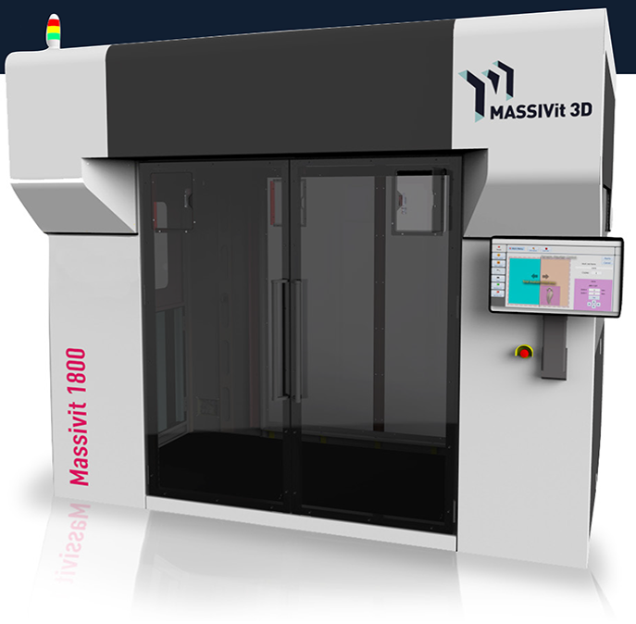
Massivit Meeting – Partner template
3D printing

Slide 2
Partner Questionnaire
Please fill slides in this presentation
We will review it together in our 1 on 1 meeting

Slide 3
Key of contacts
Please fill in your key contacts in your company that involve with Massivit activity ( E.g. Sales Manger, service engineer, application engineer)
No | Contact name | Position | E-mail | Phone number
1 | Jack Weiszberger | President | jack@ajvisualsolutions.com | 971-586-1372
2 | Sara Mohamed | Purchasing Manager | sara@ajvisualsolutions.com | 718-971-5276

Slide 4
Organizational Chart
Company organizational chart and infrastructure

Slide 5
Planned Marketing Activities for 2017
Please specify activities such as
Seminars /Trade shows/Exhibitions/Open Houses
Social Media (LinkedIn, Facebook, Twitter…)
Direct mailer
Advertising
Press Events
Others

Slide 6
Please list your 5 hot opportunities
No. | Company Name | Status | Predicted close date | Probability | Action needed to close deal
1 | Visual City | Appointment Schedule
2 | Big Apple | Speaking to Customer
3 | SPACE/CRAFT INC | Speaking to Customer
4 | Infinite Manufacturing Group, Inc. | Speaking to Customer
5 | Duggal Visual Solutions | Speaking to customer

Slide 7
The Product
What are Massivit’s main advantages, which you think may help you to succeed:
What are the sales obstacles you face today

Slide 8
Your Input
Please have your opinion in regards to:
What Massivit should to do better in order to improve the sales in your assign region?
What can be done to shorten the sales cycle?

Slide 9
Other requests
Please feel free to add any comment you believe can help us promote Massivit in your region

Slide 10
Successful 2017 Together!

